Slide 1
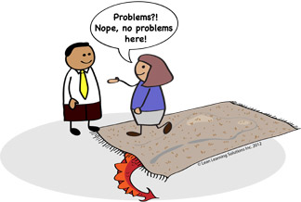

Slide 2
First thing required is
The courage To listen
the problem
Especially to the key
stakeholders / Business

Slide 3
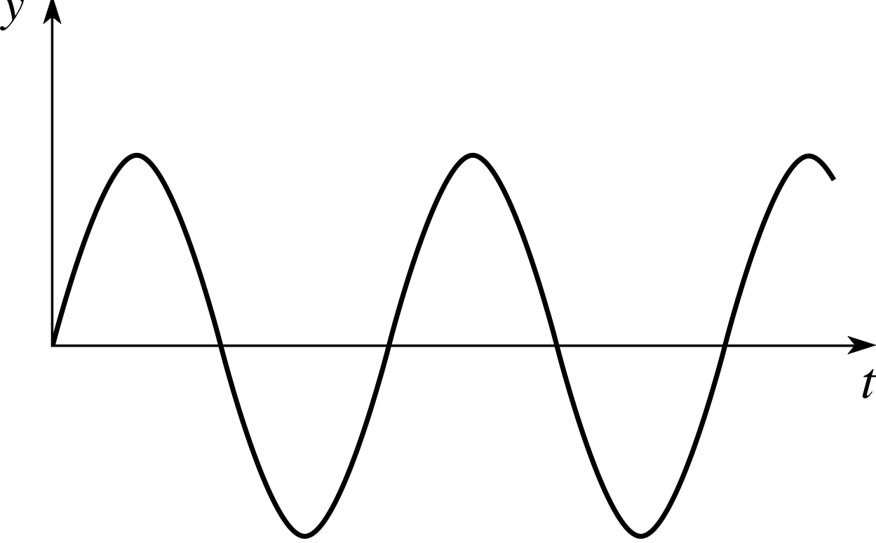
Sine Wave Theorem of Productivity

Slide 4
Lets discuss about what
to do in NEXT Build
(Low Productivity
Period)
Dev & QA
(Good Productivity Period)
UAT
(Low Productivity
Period)
Dev & QA
(Good Productivity Period)
Go Live & Immediate
Problem addressing period
(Low Productivity
Period)

Slide 5
Inefficient Delivery Process

Slide 6
Linear / Batch wise delivery
4-6Weeks
4-6Weeks
4-6Weeks
4-6Weeks
Clint A Delivered
Clint B Delivered
Clint C Delivered
Clint A Delivered
Only after 4 months PLUS
Parallel Delivery
Clint A Delivered
Merged
Challenges
Clint A Delivered

Slide 7
Challenges
Long Delivery Cycle even for small items
Repetitive Regression Testing
Deployment Process - – especially in Customization
Issues in Code Merging
Last Minute Surprises
Roll Back Readiness was difficult
Post Delivery Issues

Slide 8
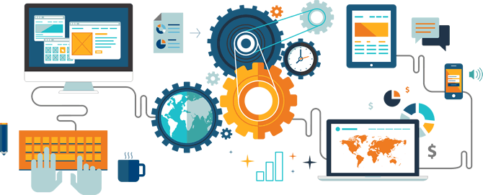
Transforming Organization
through
AUTOMATION
Presented by
Rachit & Abhishek, Skilrock Technologies

Slide 9
Agile
Not just – start taking daily meetings as STAND-UPS
What’s required to change
Thinking ahead (working when planning, Sprint Planning & SoS)
DOR (Ready, before you jump in Dev – Refinement & DOR)
Self Organized (Power to Con….)

Slide 10
Starting Steps In the Movement
Building a continuous integration system
Deployment automation
Improving culture & collaboration
Infrastructure automation
Monitoring of applications
Monitoring of infrastructure
Test automation
Version control

Slide 11
What is DevOps ?
“DevOps is development and operations collaboration”
“DevOps is treating your infrastructure as code”
“DevOps is using automation”
“DevOps is feature switches”
“DevOps is small deployments”

Slide 12
Back in the days...
Required a lot of coordinating roles
Unclear responsibilities
No Common Code for Different Client
Mannual and Time Taking Release and Deployment Process
Slow Feature Delievery to Client
Repetetive Regression Testing
No Data Base Versioning Structure

Slide 13
Technical Transition
Common Code For All Clients
Behavior Driven Development (BDD)
Test Driven Devlopment (TDD)
Automated Provisioning
Data Base Versioning
Build Automation
Artifact Management
Automated Deployment on QA
Automated Functuional Testing
Efficient Application Monitoring

Slide 14














Tech Architecture
Version
Control
GSP
Core Transaction Engine
GSP
Log Monitoring & Analytics
Encrypted APIs
Published
Skill Lotto’s
Own Portal
Skill Lotto’s
Mobile App
ASPs
Any Third Party
AS

Slide 15





Current Product Delievery Model
2 week
sprint
With in minutes
Versioning
Code
Database
Pull & Push several times a day
CI
AT
D
D
Version Control
Continuous Integration
Server
Automation Test
Server
Deploy
Server
Target Servers
(QA, Staging)

Slide 16
Tool stack
SCM
Gitlab CE
Agile
JIRA
CI
Jenkins
Maven
Gradle
Repository Manager
Nexus OSS
Unit Testing
JUnit
Mockito
Functional Test Automation
Selenium
Appium
Cucumber
Provisioning and Configuration Management
Ansible
Monitoring
Nagios, Jconsole, ELK
CI

Slide 17
Cultural Transition
Team Autonomy
Cross Funstional Teams
Self Deciplined and Responsible Teams
Refinement Sessions

Slide 18
Expecting everything will change in
a day
, is questionable !!

Slide 19
There is no
Magic
wand
for Transformation!!

Slide 20
After Implementation immediate Hickups…
Human Element
Your managers are not able to digest the shift === Power to Consensuses
If you have experienced team, then You need time to unlearn and
If you have young team, then you need team’s maturity & learning to adapt
Clients also need to change, if they continue to expect the same way… its difficult to change yourself
Working on breaking old roles / habbits
Getting everybody onboard

Slide 21
After Implementation immediate Hickups…
Tech Delivery
Initially the builds will get delayed
Have to live with the legacy code and structure (Dedicated team for catching up with Legacy code)
Two week Sprint becomes problematic – if automation is not done properly (Agile and Automation goes hand in hand) – probably you can start with three or four weeks cycle. And then move to two weeks
You need a separate FACE saving team … by the time core team is changing … (CRM)
Still mostly reactive work
Improving existing CI, CD and implementation for other Projects

Slide 22
Where do we stand today…
TBD

Slide 23
What more to achieve…
TBD

Slide 24

Final takeaways
Automation is a journey,
not a destination

Slide 25
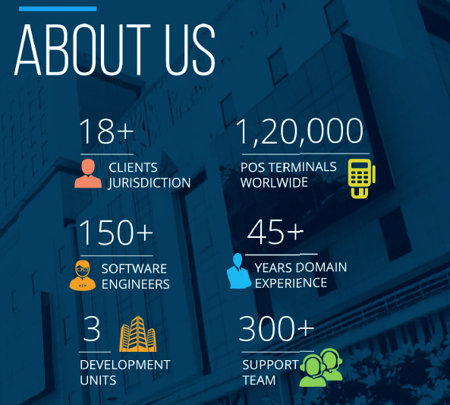

+

Slide 26
+
Back up sides

Slide 27
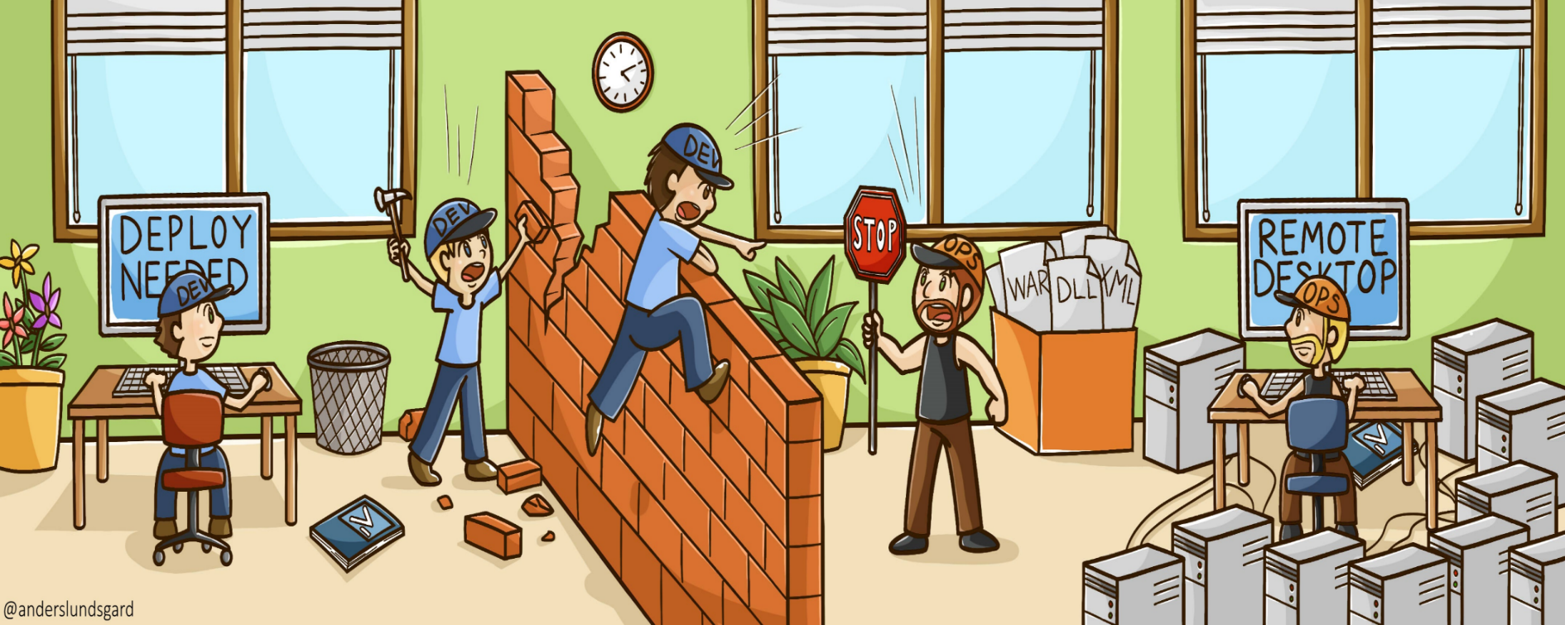
Addressing Challenges in Growing Organization
Dev
Dev
Ops

Slide 28
Knowing your customer
Responsible
Gaming
Security
Mobile Channel

Slide 29
Tech Architecture
GSP
BackOffice
GSP
Core Transaction Engine
GSP
Log Monitoring & Analytics
Encrypted APIs
Published
Skill Lotto’s
Own Portal
Skill Lotto’s
Mobile App
ASPs
Any Third Party
AS

Slide 30
Are these the only key challenges ?

Slide 31
African
^
The challenges of
transformation

Slide 32
Lets set the context right !

Slide 33
GLOBAL
LOCAL
AFRICAN
Responsible Gaming
Know Your Player
Freedom
Power
Connectivity
Cost
Payment
Channel
Content
The challenges of transformation

Slide 34
Innovation Model
Emotional Innovation
People
Desirability
Business
Viability
Technology
Feasibility
Process Innovation
Process Innovation

Slide 35
What Lotteries need?

Slide 36
The Right
Platform
Player Engagement Solution
Solution for
Smart Decisions

Slide 37


Slide 38

Transforming African Lotteries
3X3 Innovation Model

Slide 39

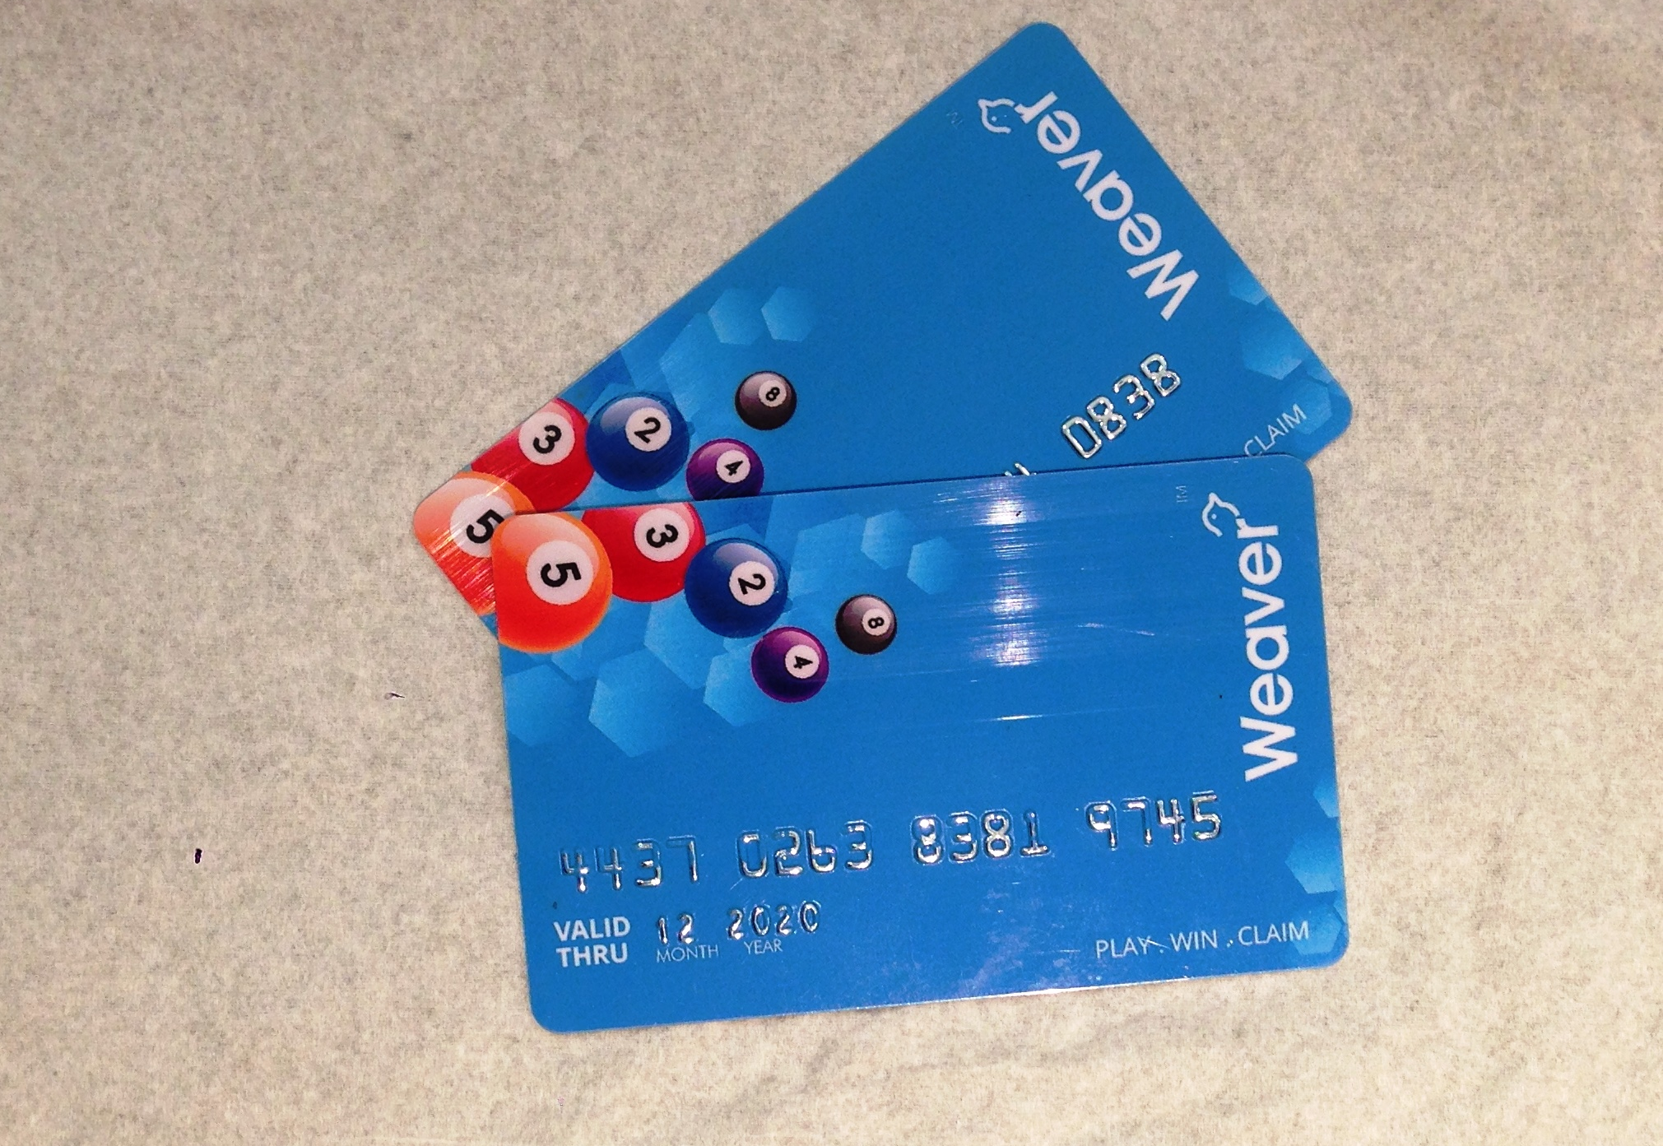
The
CARD

Slide 40
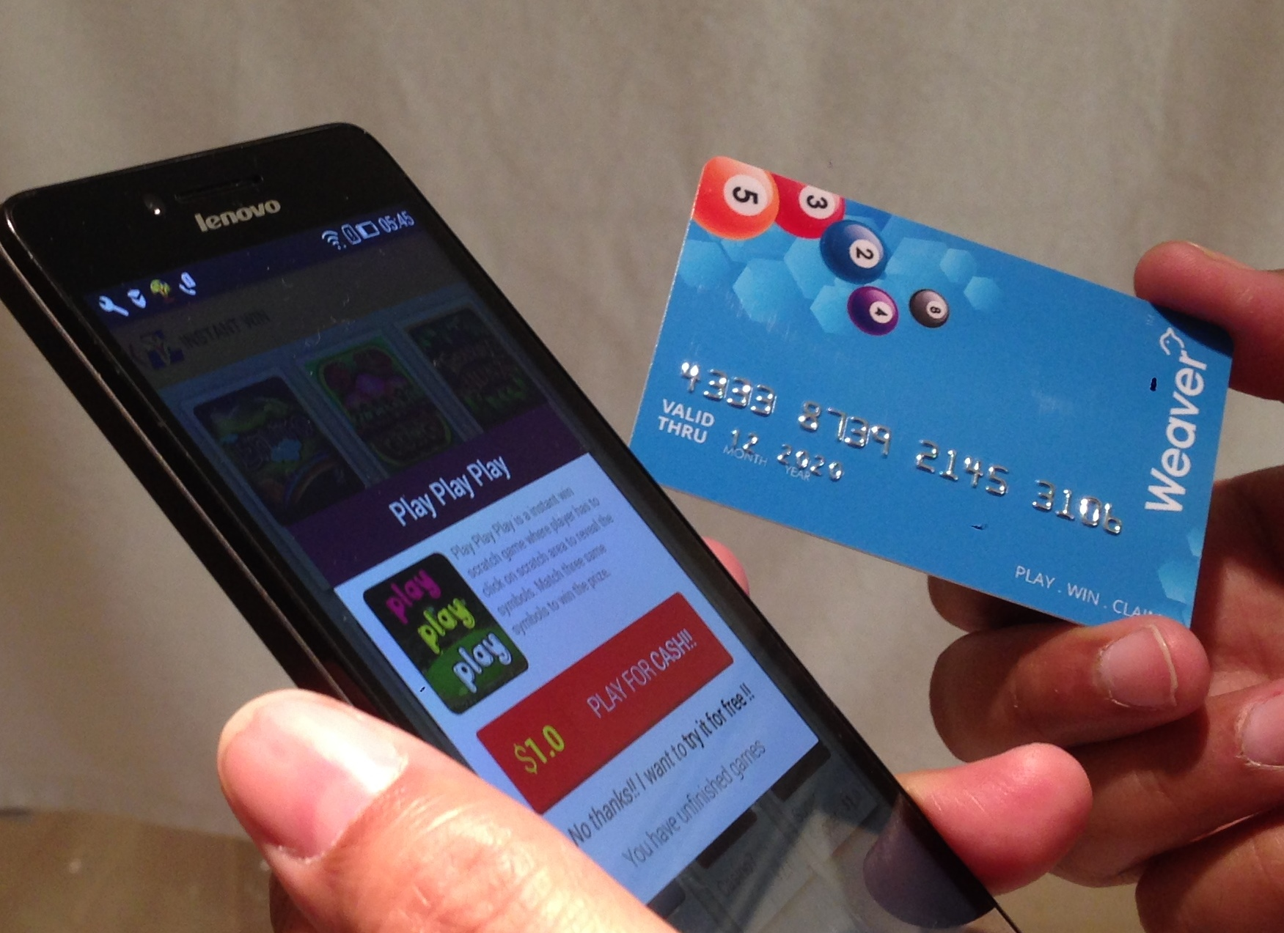
Player WALLET
WEAVER CARD also as wallet to play Mobile Lottery

Slide 41

Smart Decisions

Slide 42
Domain
Knowledge
45 Years of operational experience
Data
Science

Slide 43

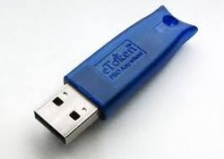

Invoices, Returns, eSign and Recon.
DEMO
Invoice
Invoice & GSTR
(View & Save)
GSTR File with eSign & DSC
1
Issue
an invoice
Skill Lotto’s
ASP Portal
AS
Accounting S/W
2
3
OR
Skill Lotto’s Agent POS
Upload Multiple Invoices (Excel)
Distributor Panel
4
Powered By
Reconciliation & Further GSTR Filing

Slide 44
User Management
DEMO
Tax Payer #1
(Owner of the GSTIN – with registered Mobile No.)
Access Rights assigned through OTP
Tax Payer #n
(Owner of the GSTIN – with registered Mobile No.)
Tax Assistant
Master User
(Master Access Rights of GSTIN is assigned to this user @ GSP)
Sub-User #1
Sub-User #2
…
Sub-User #n
Any set of privileges assigned to a sub-user for any particular set of GSTIN

Slide 45
ANALYTICS
Service
Open Data Analytics
Product
Built around
WEAVER
Platform

Slide 46
Smart Decisions
Data > Information > Knowledge > Decisions
The First Challenge : Collecting the right data and in RIGHT quantity
Analytics is not only for direct player channel, not only to address questions related to what your players are?
It focuses a lot on RETAIL business and the most relevant questions to be addressed are
Product Selling Pattern
Retailer Activity Patterns
Geo Location Distribution Analytics and Optimization
POS Terminal Life Cycle & ROI Analysis

Slide 47


LOTS, Ghana
Skilrock - Introduction
for

Slide 48
Serving 12k+
Retailer across Ghana
Together
Changed
65 year old NLA
Introduced
New
Products

Slide 49


Slide 50

Added lot more Teams
& adding
more !

Slide 51

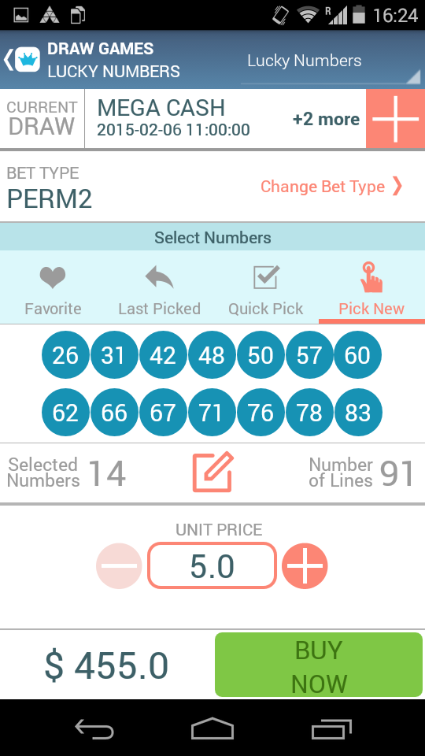
Changed
focus to
Mobile

Slide 52
& a lot more
CONFIDENTIAL
stuff

Slide 53

Lets go formal !

Slide 54
Technology Platform
Background
Private & Confidential

Slide 55



India Lottery Operations
Sugal & Damani Group (Skilrock’s Parent Group) is operating lotteries in India for more than 45 years
Holds market leader position with 65%+ Market share.
Runs 25,000+ POS Terminals
Conducts 15 Million transactions per day.
Up to 300 daily draws
Touches 400 million population
Private & Confidential

Slide 56
